Slide 1
Frogger game !
Calvin Li

Slide 2
Introduction
Frogger is a game where you play as a frog and the goal is to move the frog to reach and end location where is its home. The implementation of Frogger includes
A main start screen
Animated frog that moves with keyboard input
Audio
Death
Win
Main screen
Jump
Timer to indicate remaining time

Slide 3
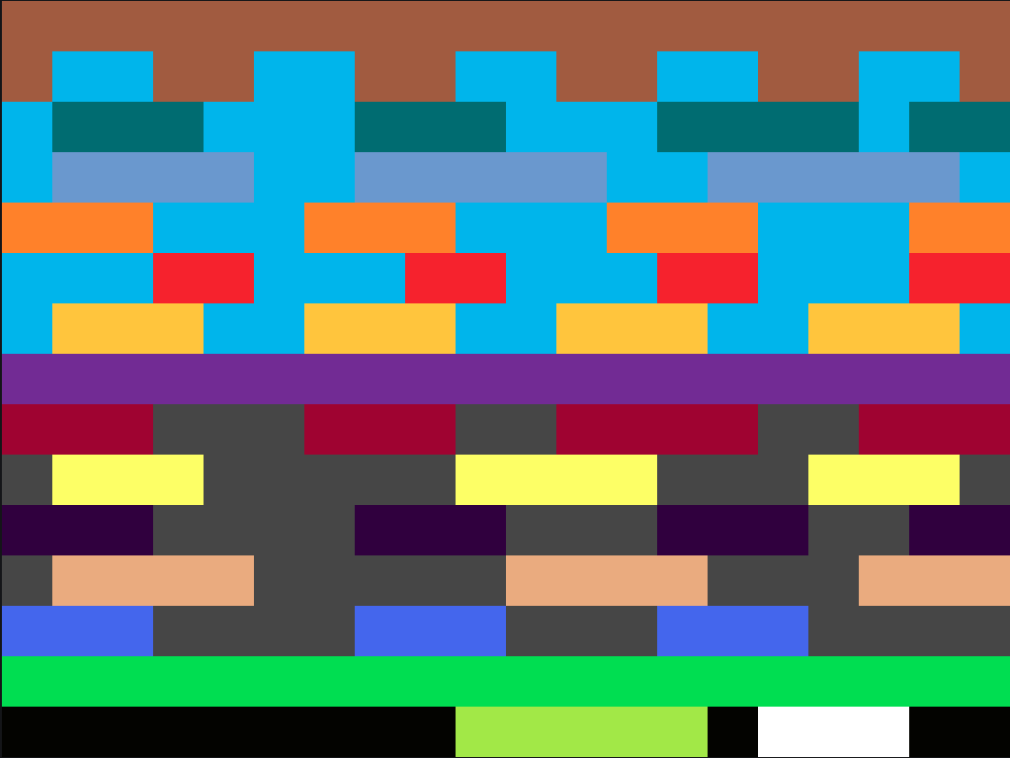

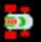
Level Design
Approach:
320x240 to 20x15 (workability)
Sprite will be drawn 16x16 pixels at a time
16
16
16

Slide 4

How to define movement?
dirY = -1
dirX = -1
Boundary Touch!
X & Y
dirY = 1
dirX = 1
(0,0)
(320,0)
X,Y
(0,240)
(320,240)
dirY = -1
dirX = -1
dirY = 1
Boundary Touch X ^=dirX
dirY = -1
dirX = 1
(0,0)
(320,0)
X,Y
(0,240)
(320,240)

Slide 5
Graphics double buffering
Recycled double buffer drawing scheme
Previous points
Buffer A
Frame1
Frame1
Frame1
Frame1
Frame1
Frame1
Frame1
Frame1
Frame1
Current frame A
Draw color black again

Slide 6
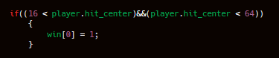
Block Diagram for win condition
X = 16
X = 64
X = 16
X = 64

Slide 7
Block Diagram of logix
The center of player defines collision if it is within bounds of log or enemy
Player
Enemy
Log
= Collision
No collision

Slide 8
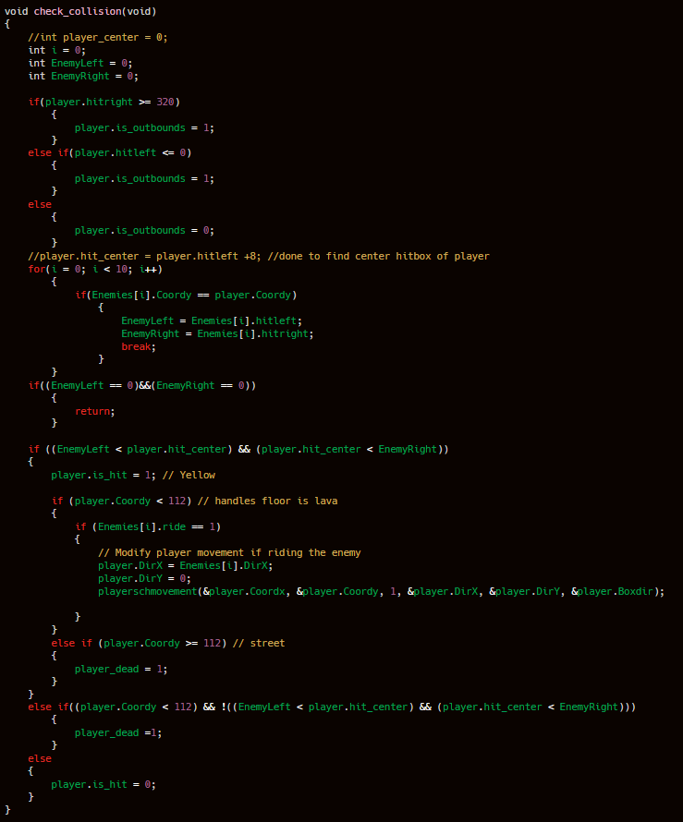
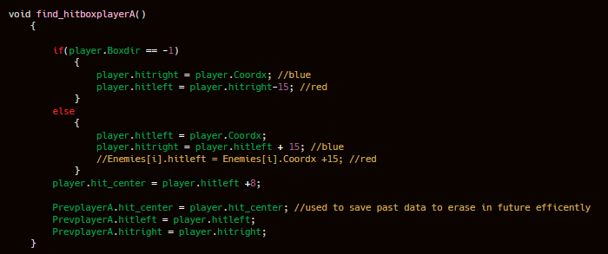
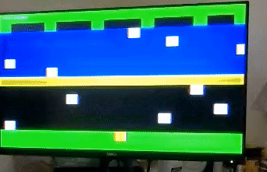
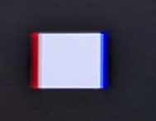
Ride + Kill + Collision

Slide 9
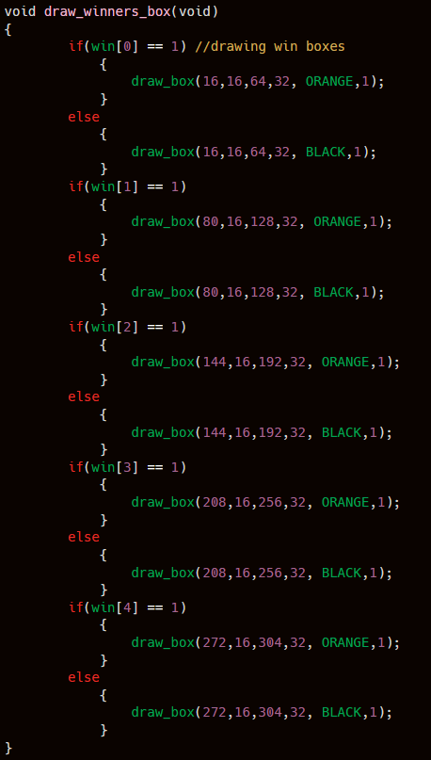
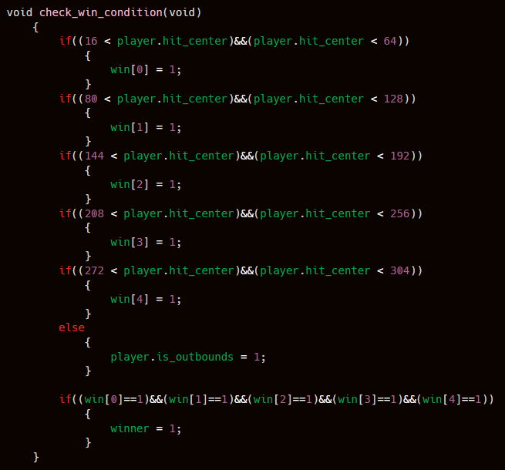
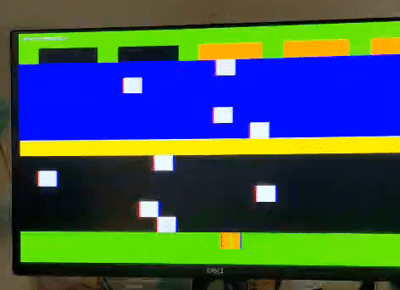
Win condition + Drawing

Slide 10
Main()
While loop (handles new game instance)
Draw environment
While loop (main menu)
Wait for key input else, stay main menu
While loop (main game)
Draw buffer A + logics for movement + erasing
Draw buffer B + logics + logics for movement + erasing
Game event logic, win flag,out of lives flag, reset entire game flag
Keyboard read in

Slide 11
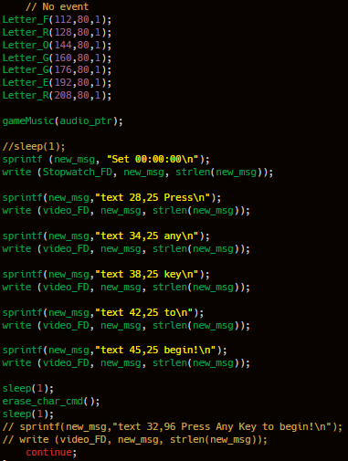
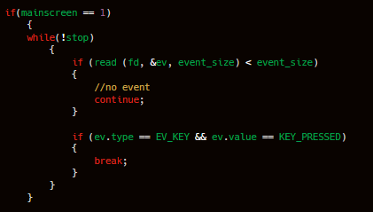
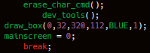
Main Screen Implementation
Analysis of keyboard input

Slide 12
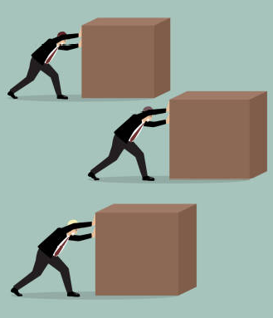
Throughput issue (user to kernel)
User space
Kernel space
CMDS
CMDS
CMDS
1 Sprite ~ 240 pixel plot cmds
61 Sprites
~15616
Pixel plot cmds
(every 1/60 s)

Slide 13
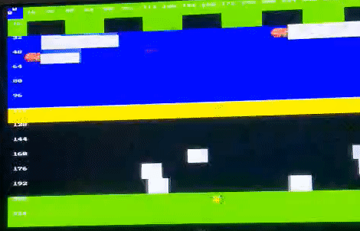
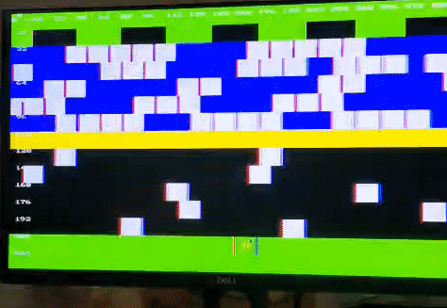
Results
Conclusion:16k cmds is not happening,incredibly low FPS and screen tearing
Solution: Treat sprite drawing like square generation
2 Sprites ONLY (~500 cmds U2K is limit)

Slide 14

Solution implementation
User space
Kernel space
CMDS
User space
Kernel space
1:~256 cmd ratio
Draw_x(x,y,dir)
Draw_spriteX(x,y,dir)
Draw_spriteZ(x,y,dir)

Slide 15
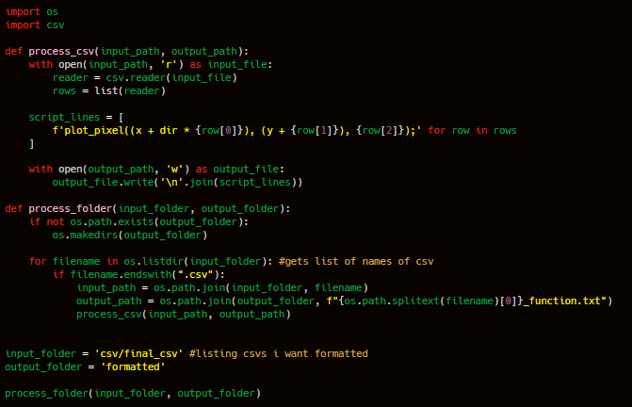
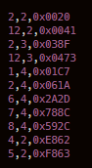
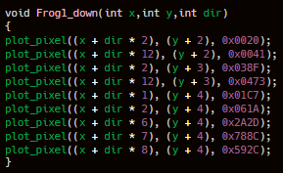
Sample of kernel sprite_draw();
Formatted function call file
Formatted function call file
Formatted function call file
CSV
Formatted function call file
CSV
Python formatter
Formatted function call file
CSV
Formatted function call file
CSV
CSV
Inside kernel

Slide 16
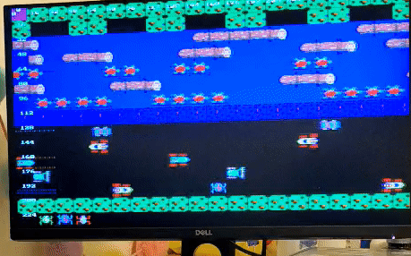
Sprite draw on user space

Slide 17
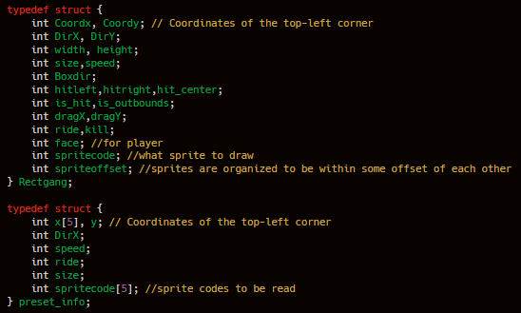
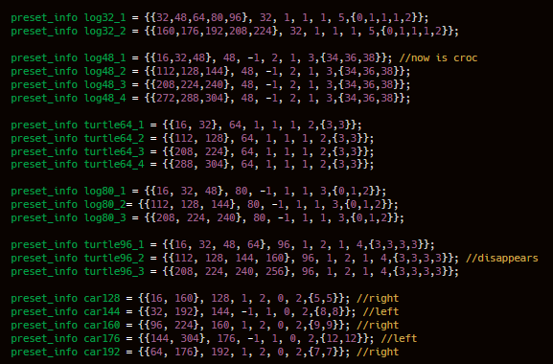
Methodology of swapping boxes for sprites
Why…?

Slide 18
Adaptive coding
Enemies stack
Sprite Log struct
Sprite struct
Sprite struct
Sprite struct
Sprite struct
Sprite Turtle struct
Sprite struct
Sprite struct
Sprite struct
Sprite struct
Sprite Car struct
Sprite X… struct
Advantages:
Organization
Simple sprite value edits
Recycle test code

Slide 19
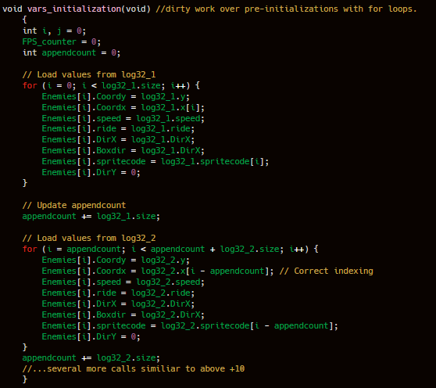
Implementing struct to stack transfer
Enemies stack
Sprite struct
Sprite struct
Sprite struct
Sprite struct
Sprite struct
Sprite struct
Sprite struct
Sprite struct

Slide 20
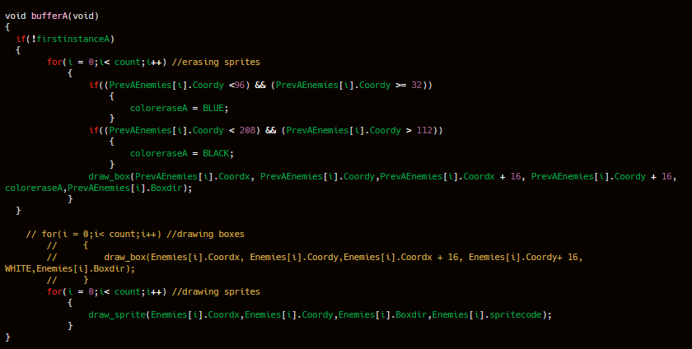
Buffer A & B adjustments (sprite handling)

Slide 21
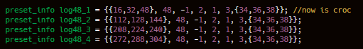
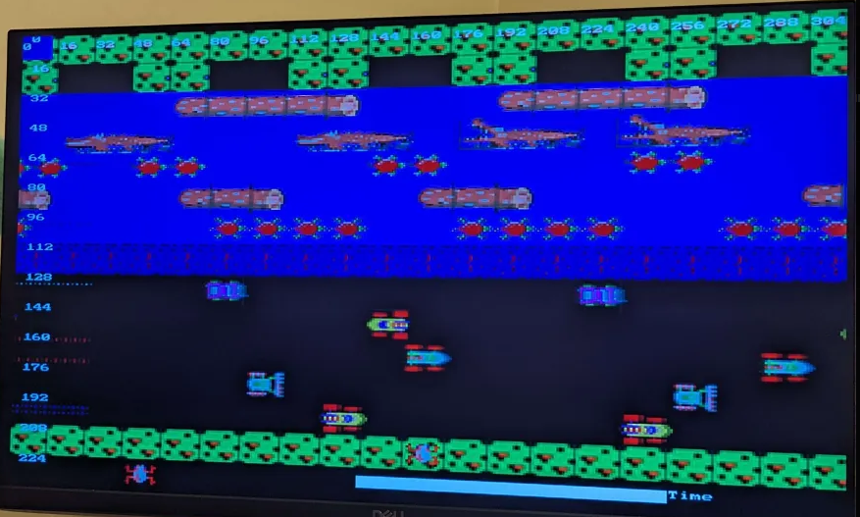
Example implementation
Draw backs (static drawings)
16
16
16

Slide 22
Adding animation flare
Main()
While loop (handles new game instance)
Draw environment
While loop (main menu)
Wait for key input else, stay main menu
While loop (main game)
Draw buffer A + logics for movement + erasing
Draw buffer B + logics + logics for movement + erasing
Talking here
Game event logic, win flag,out of lives flag, reset entire game flag
Keyboard read in

Slide 23
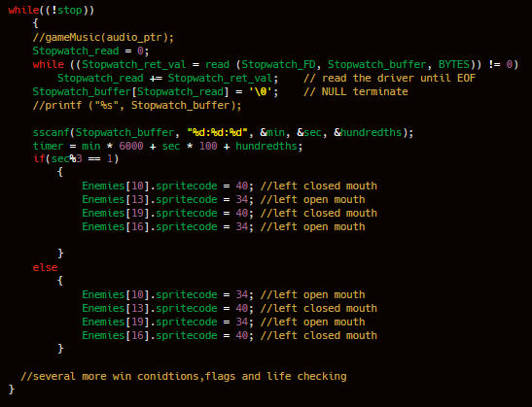

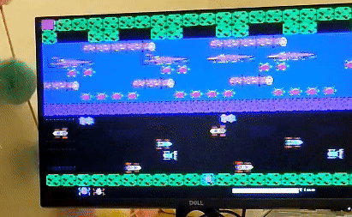
Adding animation flare
16
Sprite code = 34
16
16
Sprite code = 40
16

Slide 24

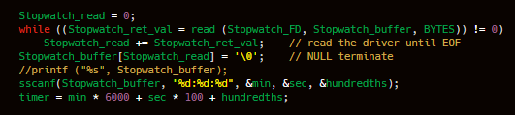
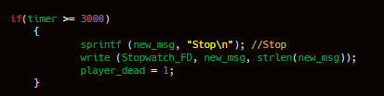
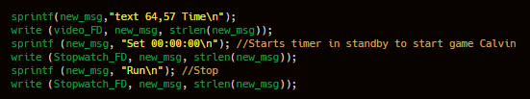
Stopwatch integration
Main()
Acquired heavy inspiration from lab 4 on usage of stopwatch driver
While loop (handles new game instance)
Draw environment
Wait for key input else, stay main menu
Stopwatch + time based events
Talking here
Draw buffer A + logics for movement + erasing
Draw buffer B + logics + logics for movement + erasing
Game event logic, win flag,out of lives flag, reset entire game flag
Keyboard read in

Slide 25
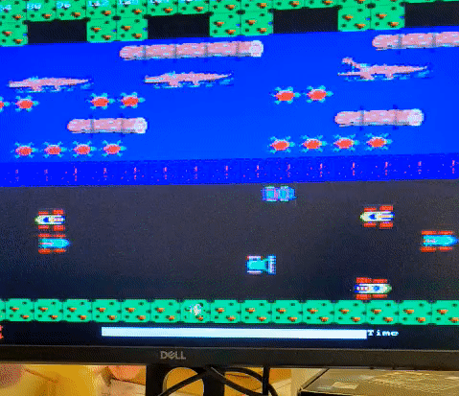
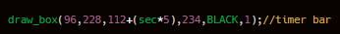
Adding countdown bar
Draw white bar on both buffers
while
Buffer A and B

Slide 26
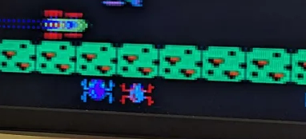
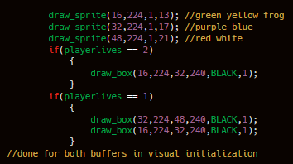
Lives + Code
Draw all frog lives at start of fresh game
Death: draw black box over

Slide 27
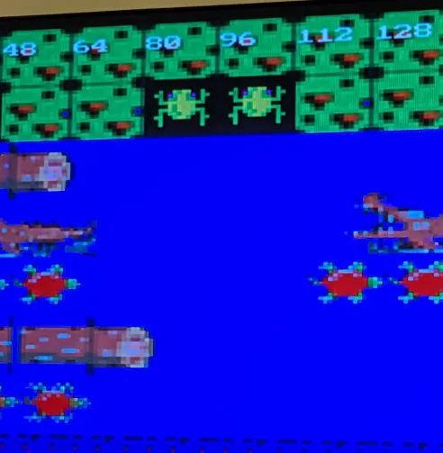
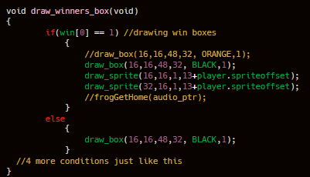
Winner sprite

Slide 28
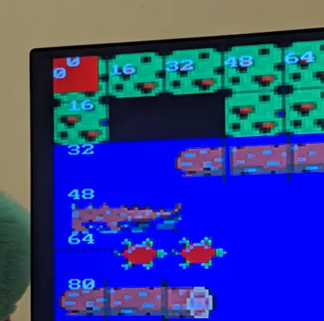
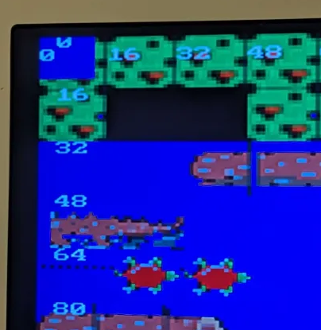
Tools
Identify buffer with issue
Grid measurement

Slide 29
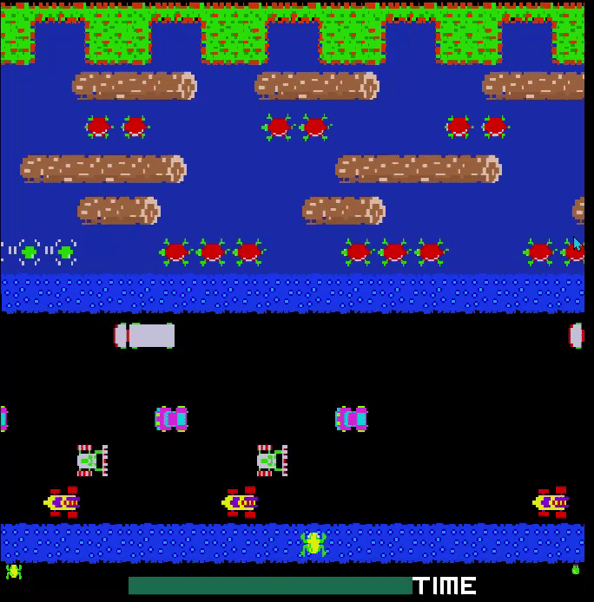
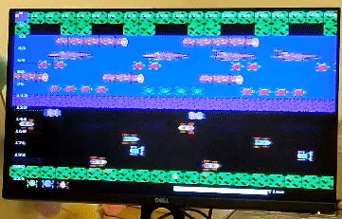
Visual comparison

